Slide 1
A Modified LEACH Protocol for Increasing Lifetime of WSN
Rohit Agrawal (18ucs094 )
Siddharth Singhvi (18ucs069)

Slide 2
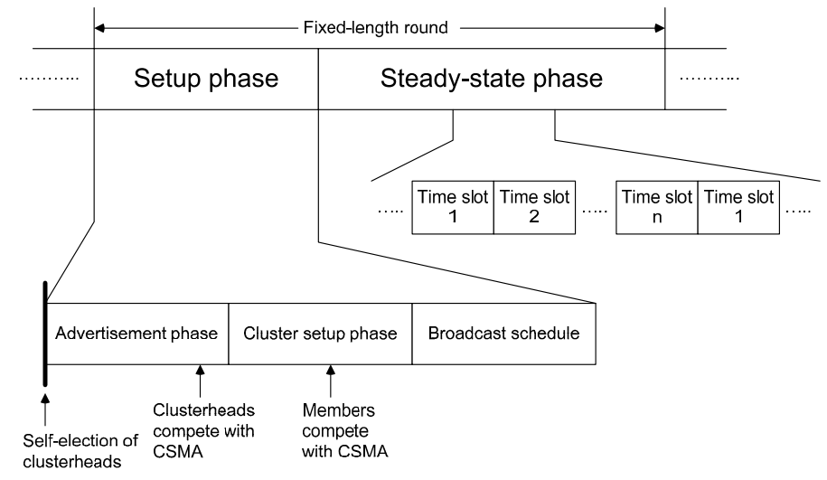
LEACH
Low Energy Adaptive Clustering Hierarchy (LEACH) protocol is a TDMA based MAC protocol. The principal aim of this protocol is to improve the lifespan of wireless sensor networks by lowering the energy consumption required to create and maintain Cluster Heads.
The operation of LEACH protocol consists of several rounds with two phases in each : Set-up Phase and Steady Phase.

Slide 3
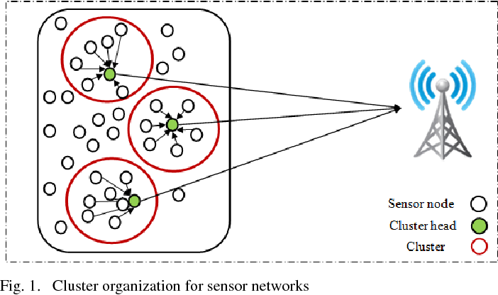
Improvement Scope in LEACH
The network lifetime is influenced by the energy consumption of each node and also selection of CHs .LEACH selects CHs on a random basis which results in decreasing the network lifetime , that’s why we need to change Cluster selection method to increase network lifetime .

Slide 4


Traditional vs Improved Clustering Methods
T
Traditional
Improved
Here, p is the desired percentage of CH, r denotes the count of present round, and G is the group of sensor nodes that are not CHs in the previous 1/p rounds.
Modified version of the cluster head selection based upon their residual energy.

Slide 5
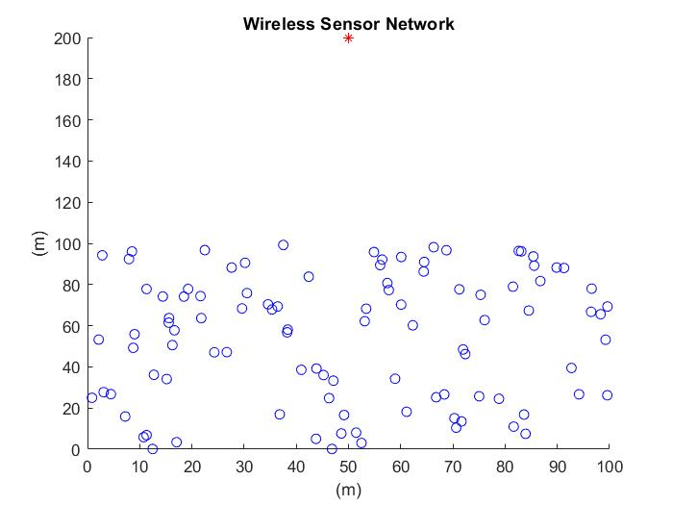
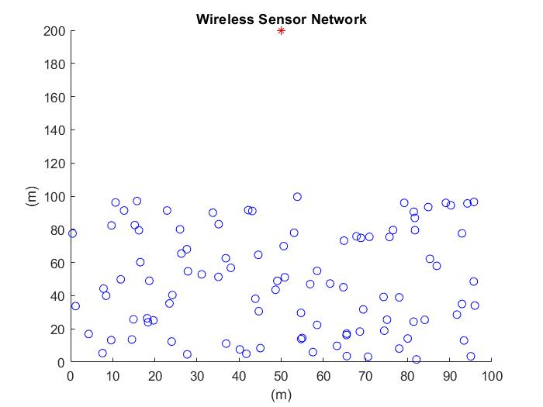
Analysis of Simulation Results
- Using MATLAB

Slide 6
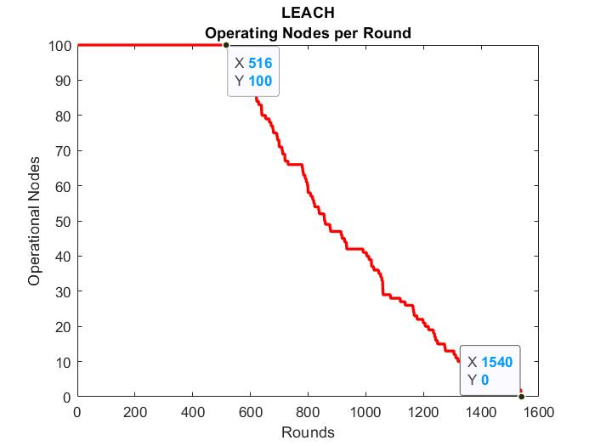

Slide 7
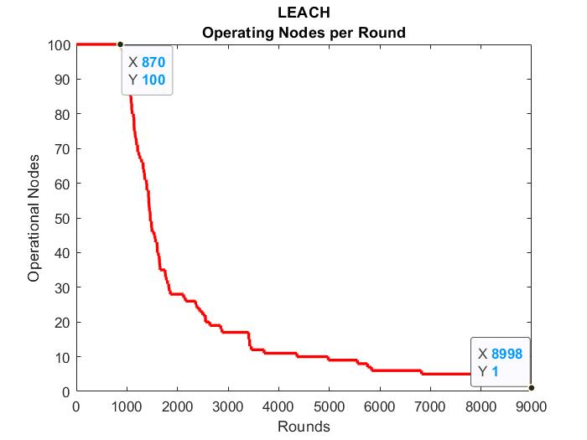

Slide 8
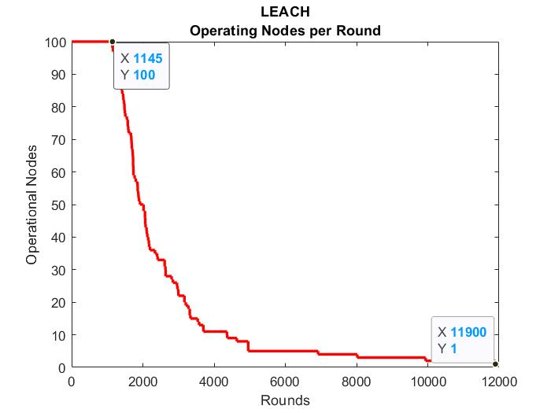

Slide 9
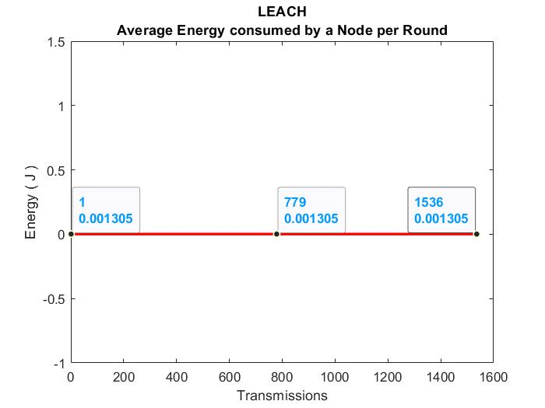
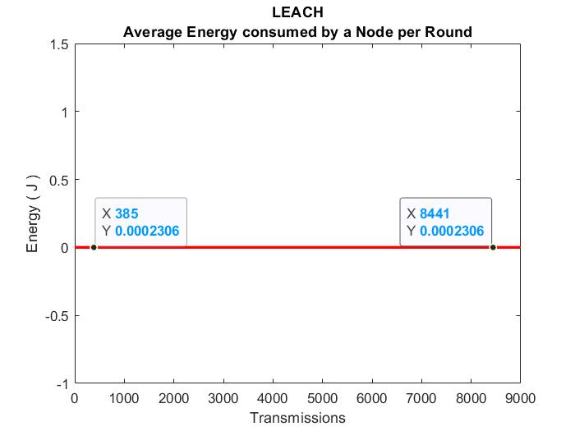

Slide 10
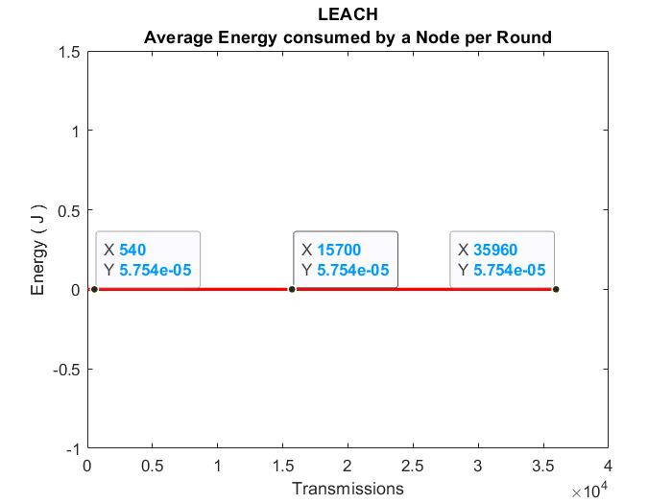
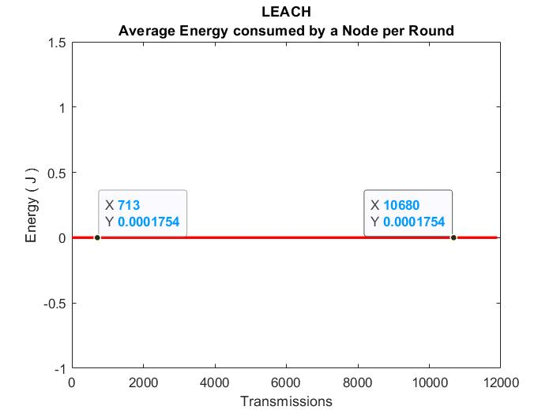

Slide 11
Conclusion
In this paper, an energy-efficient LEACH Protocol is presented to improve the lifetime of the sensor network.
The modified LEACH Protocol results in a lesser energy consumption and increased lifetime then LEACH Protocols.
The experimental results shows that the proposed LEACH yields better outcomes than the existing LEACH Protocols.

Slide 12
REFERENCES
Paper Title: The Improvement of LEACH Protocol in WSN
Author: Yuling Li, Luwei Ding and Feng Liu

Slide 13
Thanks!

